Slide 1
Data Analytics Lifecycle
Data science projects differ from BI projects
  More exploratory in nature
  Critical to have a project process
  Participants should be thorough and rigorous
Break large projects into smaller pieces
Data Analytics Lifecycle defines the analytics process and best practices from discovery to project completion.

Slide 2
Data Analytics Lifecycle
Data Analytics lifecycle Phases:
Discovery Phase
Data Preparation Phase
Model Planning Phase
Model Building Phase
Communicate Result
Operationalize

Slide 3
Data Analytics Lifecycle
With six phases the project work can occur in several phases simultaneously
The cycle is iterative to portray a real project
Work can return to earlier phases as new information is uncovered

Slide 4
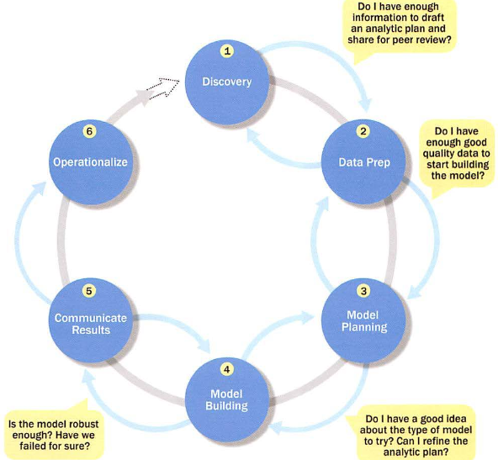
Data Analytics Lifecycle

Slide 5
Data Analytics Lifecycle
Phase – I: Discovery
  Learning the Business Domain
  Resources
  Framing the Problem
  Developing Initial Hypotheses
  Identifying Potential Data Sources

Slide 6
Data Analytics Lifecycle
Phase – 2: Data Preparation
  It requires analytical sandbox in which you can perform analytics for the entire duration of the project
  Includes steps to
    Explore
    Preprocess
    Conditional Data
  Data preparation tends to be the most labor-intensive step in the analytics lifecycle
    Often at least 50% of the data science project’s time
  The data preparation phase is a iterative process

Slide 7
Data Analytics Lifecycle
Phase – 2: Data Preparation
  In ETL users perform extract, transform, load
  Data Analytics lifecycle → ELT or ETLT → Extract, Transform, Load and Transform.
    early load preserves the raw data which can be useful to examine.
  Example :
    In credit card fraud detection, outliers can represent high-risk transactions that might be inadvertently filtered out or transformed before being loaded into the database

Slide 8
Data Analytics Lifecycle
Phase – 2: Data Preparation
  In ETL users perform extract, transform, load
  Data Analytics lifecycle → ELT or ETLT → Extract, Transform, Load and Transform.
    early load preserves the raw data which can be useful to examine.
  Example :
    In credit card fraud detection, outliers can represent high-risk transactions that might be inadvertently filtered out or transformed before being loaded into the database

Slide 9
Data Analytics Lifecycle
Phase – 2: Data Preparation
  In ETL users perform extract, transform, load
  Data Analytics lifecycle → ELT or ETLT → Extract, Transform, Load and Transform.
    early load preserves the raw data which can be useful to examine.
  Example :
    In credit card fraud detection, outliers can represent high-risk transactions that might be inadvertently filtered out or transformed before being loaded into the database

Slide 10
Data Analytics Lifecycle
Phase – 3: Model Planning
  This determines the methods and techniques to extract relationships among variables.
  These relationship patterns will set the base for algorithms which will be used in next phase
  It uses Exploratory Data Analysis (EDA) using various statistical formulae and visualization tools.
  Simply, it identifies candidate models to apply to the data for clustering, classifying, or finding relationships in data.

Slide 11
Data Analytics Lifecycle
Phase – 3: Model Planning
  Activities to consider:
    Assess the structure of the data
    Ensure the analytic techniques enable the team to meet the business objectives and accept or reject the working hypotheses
    Determine if the situation warrants a single model or a series of techniques as part of a larger analytic workflow
    Research and understand how other analysts have approached this kind or similar kind of problem

Slide 12
Data Analytics Lifecycle
Phase – 4: Model Building
  Execute the models defined in Phase 3
  Develop datasets for training, testing, and production
  Develop analytic model on training data, test on test data.
  It will consider whether your existing tools will suffice for running the models or it will need a more robust environment (like fast and parallel processing).
  You will analyze various learning techniques like classification, association and clustering to build the model.

Slide 13
Data Analytics Lifecycle
Phase – 5: Communicate Results
  Determine if the team succeeded or failed in its objectives
  Assess if the results are statistically significant and valid
    If so, identify aspects of the results that present salient findings
    Identify surprising results and those in line with the hypotheses
  Communicate and document the key findings and major insights derived from the analysis
  This is the most visible portion of the process to the outside stakeholders and sponsors

Slide 14
Data Analytics Lifecycle
Phase – 6: Operationalize
  In this last phase, the team communicates the benefits of the project more broadly and sets up a pilot project to deploy the work in a controlled way
  Risk is managed effectively by undertaking small scope, pilot deployment before a wide-scale rollout
  During the pilot project, the team may need to execute the algorithm more efficiently in the database

Slide 15
Data Preprocessing Techniques
Need of Data Preprocessing:
  Incomplete:
    Missing attribute values,
    Lack of certain attributes of interest
    Consisting of aggregated values
  Noisy Data
    Contains errors
    Outliers
  Inconsistent
    containing discrepancies in codes or names

Slide 16
Data Preprocessing Techniques
Need of Data Preprocessing:
  Quality data is required for better identification of Model
Major tasks in Data Processing
  Data Cleaning
  Data Integration
  Data Transformation
  Data Reduction
  Data Discretization

Slide 17
Data Preprocessing Techniques
Data Cleaning:
  Data cleaning is important, because data is collected from different data sources.
  Data Cleaning Tasks are:
    Fill the missing Values
    Identify the outliers and smooth out noisy data
    Correct inconsistent data
    Resolve the redundancy caused by data integration

Slide 18
Data Preprocessing Techniques
How to handle missing data?
  Ignore the tuple (loss of information)
  Fill in missing values manually (Complex task)
  Use a measure of central tendency for the attribute to fill the missing value
    Middle value of the data distribution
    Mean, median etc.
  Use the attribute mean or median for all samples belonging to the same class as the given tuple.
  Use the most probable value to fill in the missing value: regression , inference-based tools using Bayesian formula, decision tree, EM algorithm

Slide 19
Data Preprocessing Techniques
Noisy Data: Random error or variance in a measured variable
How to handle Noisy Data?
  Binning Method
    Sort the data and partition into (equal-size) bins
    Smooth by bin means, Smooth by bin Medians, Smooth by bin Boundaries, etc
  Clustering method, Curve-fitting, Regression
    Detects and removes the outliers
  Combined computer and human inspection
    Detect the suspicious values and check by human

Slide 20
Data Preprocessing Techniques
Noisy Data: Random error or variance in a measured variable
Simple Discretization Methods: Binning
  Equal-width(distance) partitioning:
    It divides the range into N intervals of equal size: uniform grid
    if A and Bare the lowest and highest values of the attribute, the width of intervals will be: W = (B-A)/N.
    The most straightforward
    But outliers may dominate presentation
    Skewed data is not handled well

Slide 21
Data Preprocessing Techniques
Noisy Data: Random error or variance in a measured variable
Simple Discretization Methods: Binning
  Equal-depth(frequency) partitioning:
    It divides the range into N intervals, each containing approximately same number of samples
    Good data scaling
    Managing categorical attributes can be tricky.
Binning method for data mining in next slide with example

Slide 22
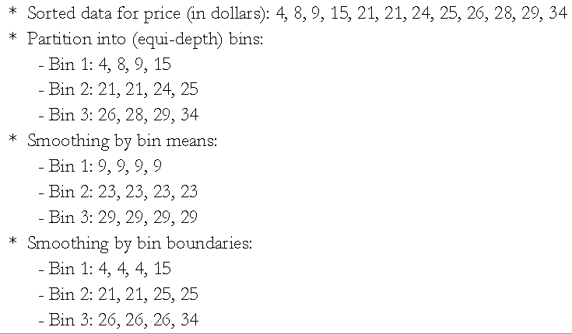
Data Preprocessing Techniques

Slide 23
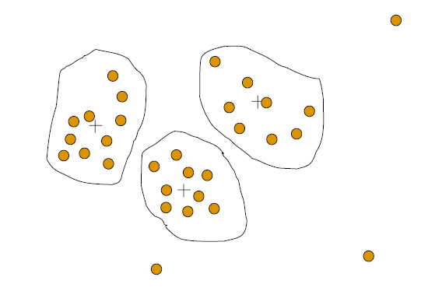
Data Preprocessing Techniques
Noisy Data: Random error or variance in a measured variable
Cluster Analysis:

Slide 24
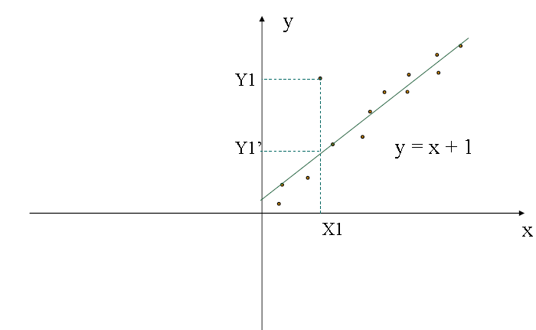
Data Preprocessing Techniques
Noisy Data: Random error or variance in a measured variable
Regression:

Slide 25
Data Preprocessing Techniques
Data Integration:
  combines data from multiple sources into a coherent store → Data Warehouse
Schema integration:
  integrate metadata from different sources.
  Entity identification problem example: A.custID = B.custNumber
  Solution: entity identification → problems → meta data
Detecting and resolving data value conflicts:
  for the same real world entity, attribute values from different sources are different
  possible reasons: different representations, different scales, e.g., metric vs. British units

Slide 26
Data Preprocessing Techniques
Handling Redundant data in Data Integration:
  The situations which leads to redundancy are
    Inconsistency: inconsistencies in attributes or dimension naming, example: Derivable data
    Object Identification: The same attribute may have different names in different databases
Detected by correlational analysis:
  helps to determine how strongly one attribute implies the other attribute.
Careful integration of the data from multiple sources may help reduce/avoid redundancies and inconsistencies and improve mining speed and quality

Slide 27
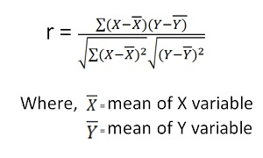
Data Preprocessing Techniques
Handling Redundant data in Data Integration:
  Correlation Analysis: (Pearson’s product moment coefficient )
    It lies between -1 and +1
    The higher the coefficient value the stronger the correlation
    if the correlation coefficient is greater than 0 that means A and B are positively correlated.
    If correlation coefficient is equal to 0 then we call that the attribute A and B are independent that means they are not correlated.
    if the correlation coefficient is negative then we say that A and b are negatively correlated.

Slide 28

Data Preprocessing Techniques
Handling Redundant data in Data Integration:
  Correlation Analysis: (Pearson’s product moment coefficient )
    chi-square test to determine the correlation.
    Suppose A has c-distinct values. a₁,a₂,a₃…a_{c}
    Suppose B has r-distinct values. b₁,b₂,b₃…b_{r}
    Use the contingency table to describe the tuples of A and B, with c-values of A making up columns and the r-values of B making up the rows.
    A table summarization of two categorical variables in this form is called a contingency table. → contingency table
    Joint event has its own cell or slot in the table. → Joint event (A_{i},B_{j}).

Slide 29
Data Preprocessing Techniques
Handling Redundant data in Data Integration:
  Correlation Analysis: (Pearson’s product moment coefficient )
    chi-square test to determine the correlation.
    Suppose A has c-distinct values. a₁,a₂,a₃…a_{c}
    Suppose B has r-distinct values. b₁,b₂,b₃…b_{r}
    Use the contingency table to describe the tuples of A and B, with c-values of A making up columns and the r-values of B making up the rows.
    a table summarization of two categorical variables in this form is called a contingency table.
    Joint event has its own cell or slot in the table. → Joint event (A_{i},B_{j}).

Slide 30

Data Preprocessing Techniques
Handling Redundant data in Data Integration:
  Correlation Analysis: (Pearson’s product moment coefficient )
    Joint event has its own cell or slot in the table. → Joint event (A_{i},B_{j}).
    Where o_{ij} is the observed frequency of the joint event (A_{i},B_{j}) and e_{ij} is the expected frequency of (A_{i},B_{j}).
    where N is the number of data tuples, count(A = a_{i}) is the number of tuples having value a_{i} for A like wise count(B = b_{j})

Slide 31
Data Preprocessing Techniques
Handling Redundant data in Data Integration:
  Correlation analysis of categorical attributes using person chi-square statistic:
Suppose that a group of 1,500 people was surveyed. The gender of each person was noted. Each person was polled as to whether their preferred type of reading material was fiction or nonfiction. Thus, we have two attributes, gender and preferred reading. The observed frequency (or count) of each possible joint event is summarized in the contingency table. Where the numbers in parentheses are the expected frequencies

Slide 32
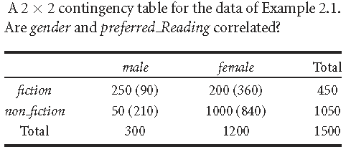
Data Preprocessing Techniques
Handling Redundant data in Data Integration:
  Correlation analysis of categorical attributes using person chi-square statistic:

Slide 33

Data Preprocessing Techniques
Handling Redundant data in Data Integration:
  Correlation analysis of categorical attributes using person chi-square statistic:
  Assume the degree of freedom is (r-1) x (c-1) → (2-1) x (2-1) = 1
  For 1 degree of freedom, the chi-square value needed to reject the hypothesis at the 0.001 significance level is 10.828.
  Since our computed value is above this, we can reject the hypothesis that gender and preferred reading are independent and conclude that the two attributes are (strongly) correlated for the given group of people.

Slide 34
Data Preprocessing Techniques
Data Transformation:
  The data are transformed or consolidate into forms appropriate for mining
  Data transformation can involve following:
    Smoothing: removes noise from data
    Aggregation: summarization, etc
    Generalization: Concept of hierarchy climbing
    Normalization: scale to fall within a small, specified range
    Attribute or feature construction: new attributes are constructed from given set of attributes.

Slide 35
Data Preprocessing Techniques
Data Transformation:
  Normalization:
    Min-max normalization
    Z-score normalization
    Normalization by decimal scaling

Slide 36

Data Preprocessing Techniques
Data Transformation:
  Min-max normalization:
    It performs the linear transformation on original data
    It preserves the relationships among the original data values.
    Suppose min_{A} and max_{A} are the minimum and maximum values of an attribute, A.
    It maps the value v of A to v’ in the range [new_min_{A}, new_max_{A}] using formula

Slide 37
Data Preprocessing Techniques
Data Transformation:
  Min-max normalization: Example
    Suppose that the minimum and maximum values for the attribute income are 12,000 and 98,000 respectively. We would like to map income to the range [0.0,1.0]. By min-max normalization, a value of 73,000 for income is transformed to
    (73,600 – 12,000)/(98,000-12,000) * (1.0-0.0) + 0.0 = 0.716

Slide 38

Data Preprocessing Techniques
Data Transformation:
  Z-score normalization: (Zero – mean normalization)
    The values of an attribute A, are normalized based on the mean and standard deviation of A.
    One of the value – v of A, is normalized to v’ using
    Where and are the mean and standard deviation of attribute A, respectively.
    It is useful when the actual min and max of attribute A are unknown.

Slide 39
Data Preprocessing Techniques
Data Transformation:
  Z-score normalization: Example
    Suppose that the mean and standard deviation of the values for the attribute income are 54000 and 16000 respectively.
    The z-score normalization value of 73000 for income attribute A is transformed to
    (73,600 – 54,000) /16,000 = 1.225

Slide 40

Data Preprocessing Techniques
Data Transformation:
  Normalization by decimal scaling:
    It normalizes by moving the decimal point of values of attribute A.
    The number of decimal points moved depends on the maximum absolute values of A.
    The value – v of A is normalized to v’ by using following formula
    Where j is the smallest integer such that max(|v’|) < 1

Slide 41
Data Preprocessing Techniques
Data Transformation:
  Normalization by decimal scaling: ex
    Suppose that the recorded values of A range from −986 to 917.
    The maximum absolute value of A is 986.
    To normalize by decimal scaling, we therefore divide each value by 1,000 (i.e, j=3) that −986 normalizes to −0.986 and 917 normalizes to 0.917.

Slide 42
Data Preprocessing Techniques
Data Reduction:
  Warehouse may store terabytes of data.
  Complex data analysis/mining may take a very long time to run on the complete data set
  So, Data Reduction is required
    Obtains a reduced representation of the data set that is much smaller in volume but yet produces the same (or almost the same) analytical results

Slide 43
Data Preprocessing Techniques
Data Reduction strategies:
  Data cube aggregation
    Aggregation operations are applied on the data in the construction of data cube
  Attribute subset selection
    Irrelevant, weakly relevant, redundant attributes may be removed
  Dimensionality reduction
    Use mechanism to reduce the data set size
  Numerosity reduction
    Data are replaced by alternatives

